Slide 1

What’s the Deal with Rhino.Mocks?
Steven Harman
blog: stevenharman.net
twitter: stevenharman

Slide 2

A bit about the language
Test Doubles
Notes:
Generic term for any kind of pretend object used in place of real object for testing purposes

Slide 3

Dummy
Notes:
Passed around but never actually used. Usually just used to fill parameter lists.

Slide 4

Fake
Notes:
actually have working implementations, but take shortcut so not suitable for production (i.e.- in memory database)

Slide 5

M*ch*gan 32 - App State 34

Slide 6

Stubs
Notes:
provide canned answers to calls made during the test, usually not responding to anything outside what's programmed in for the test.
May also record information about calls (email gateway stub that remembers messages it 'sent’ or how many messages it 'sent‘)

Slide 7
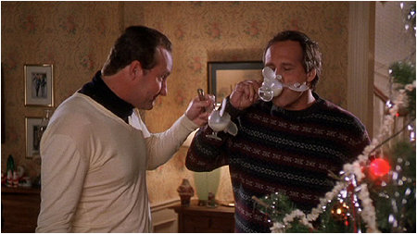
Mocks
Notes:
objects pre-programmed with expectations which form a specification of the calls they are expected to receive.

Slide 8

Its all about interactions
Objects talking to objects
Notes:
State based testing is OK
Interaction, or behavior verification testing is more interesting

Slide 9
Make unit testing easier
Fake the hard stuff
Outside resources
Internal resources
Anything hard to setup
Notes:
External – Networks, Databases, other systems
Internal – other objects,
Other – Legacy code! (any code w/out tests around it)

Slide 10
What is Rhino.Mocks?
“A dynamic mock object framework for .net”
Notes:
.NET tool for creating object that mimic real objects for testing.

Slide 11
Kinds of mocks
Strict Mock
Dynamic Mock
Stub
Partial
Arrange, Act, Assert

Slide 12
Structure of a Record/Playback test
Create mocks
Define expectations/results on the mocks
Execute code under test
Verify expectations
Additional asserts [optional]

Slide 13
Structure of an AAA test
Create mocks
Stub results for the mocks [optional]
Execute code under test
Verify expectations
Additional asserts [optional]

Slide 14
Enough chatter
Lets see some code!
HAI
CAN HAS STDIO?
VISIBLE "HAI WORLD!“
KTHXBYE

Slide 15
Rhino.Mocks … Rocks!
Get Rhino.Mocks
http://ayende.com/projects/rhino-mocks.aspx
Get this deck & code
http://codeincubator.com
Me
blog: stevenharman.net
twitter: stevenharman
email: steven@stevenharman.net

